Slide 1
Contact Manager
COP 4331C - Object Oriented Software Development

Slide 2
Team Members
Project Manager
Pallavi Dacre
Frontend | API | Database
Steffen J. Camarato Dennis Gebken | Matthew Bonsignore Adam Henderson | Mark Nguyen Alexander Hunt

Slide 3
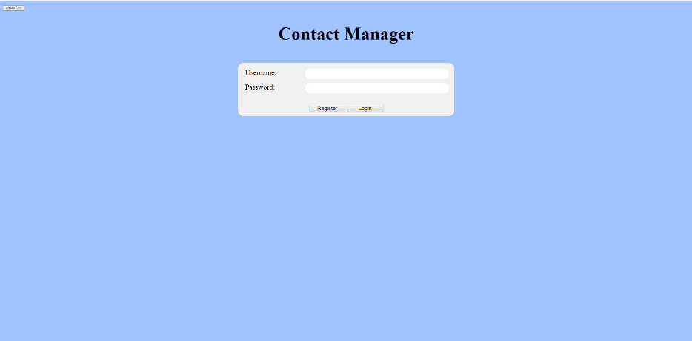
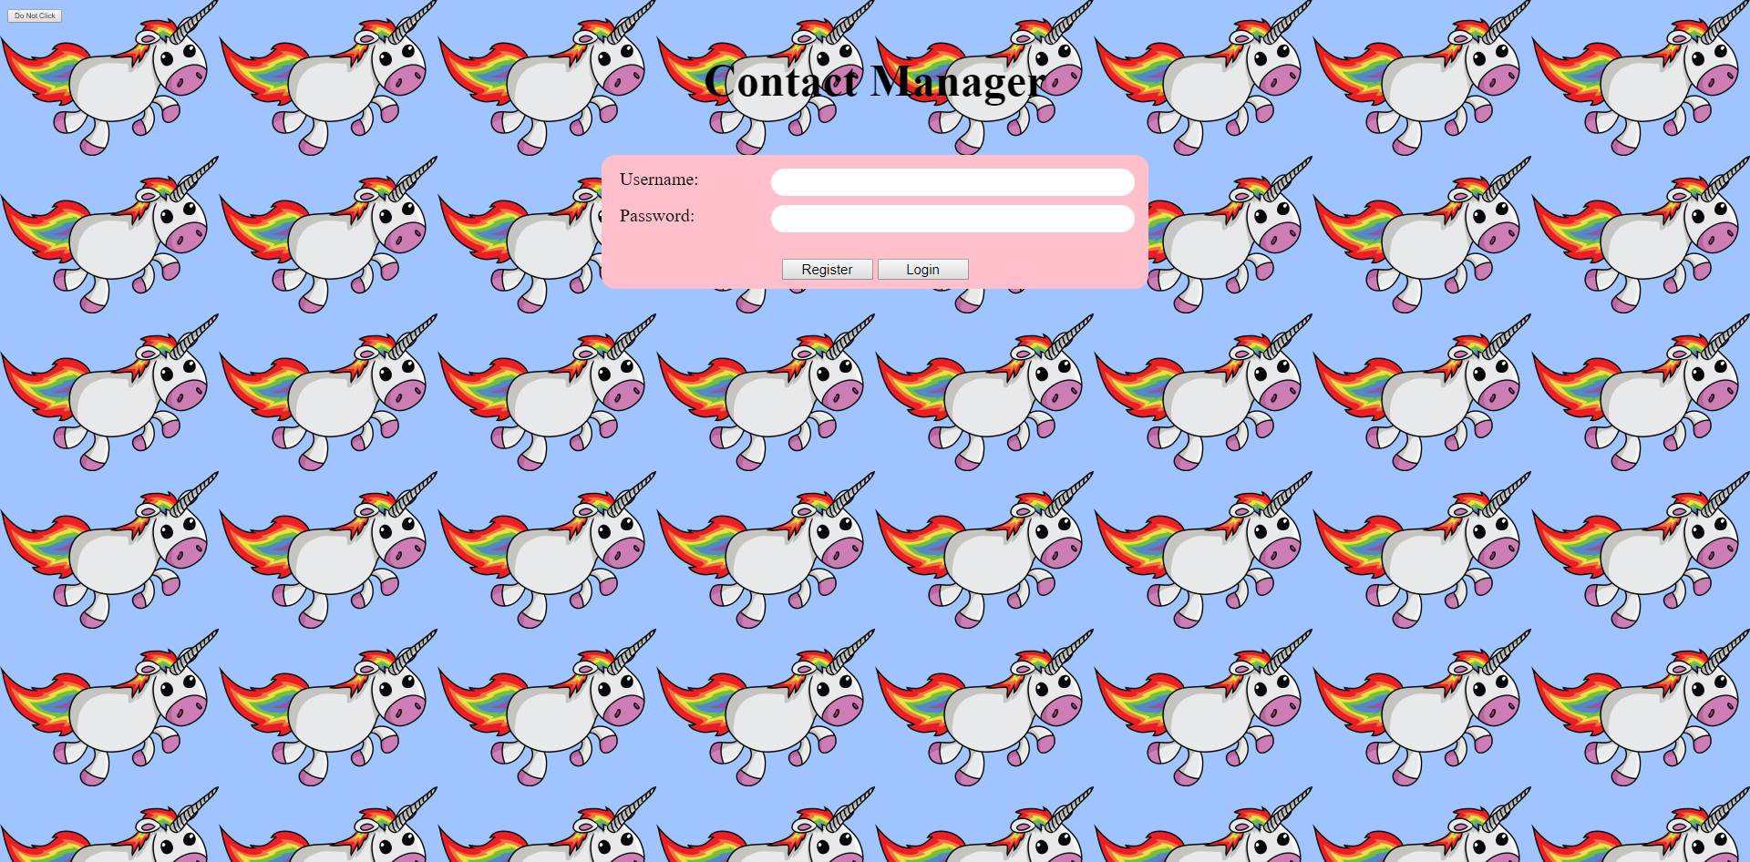
Functionalities
Provide users a secure login into a remote database
Helping users manage their contacts with a simplistic user interface

Slide 4
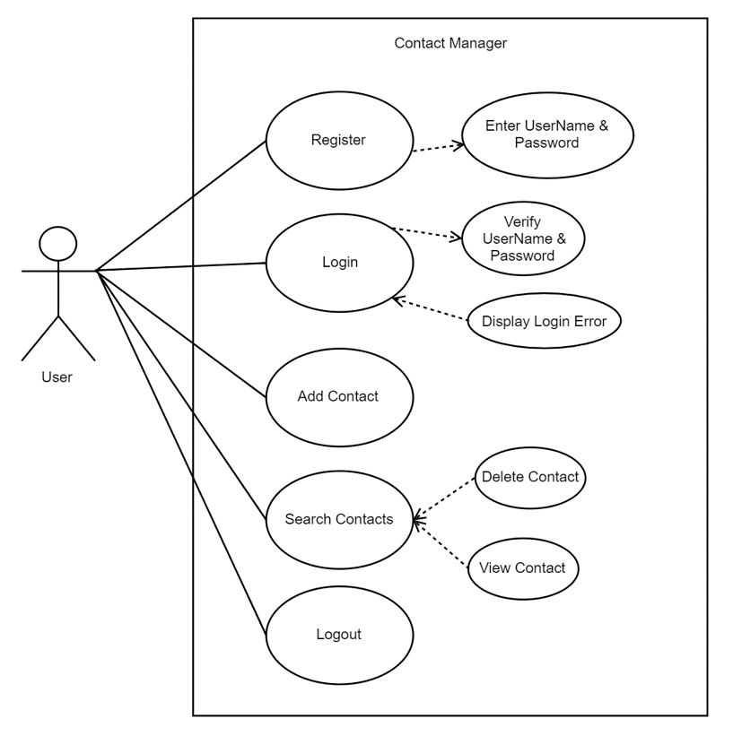
Use Case Diagram
System: Contact Manager
Actor: User (primary actor - displayed to the left)
Base Use Cases: Register, Login, Add Contact, Search Contacts, Logout
Included Use Cases: Enter UserName & Password, Verify UserName & Password
Extended Use Cases: Display Login Error, Delete Contact, View Contact; Delete and View are extended from Search, because the user must search for the contact before they can view or delete it

Slide 5
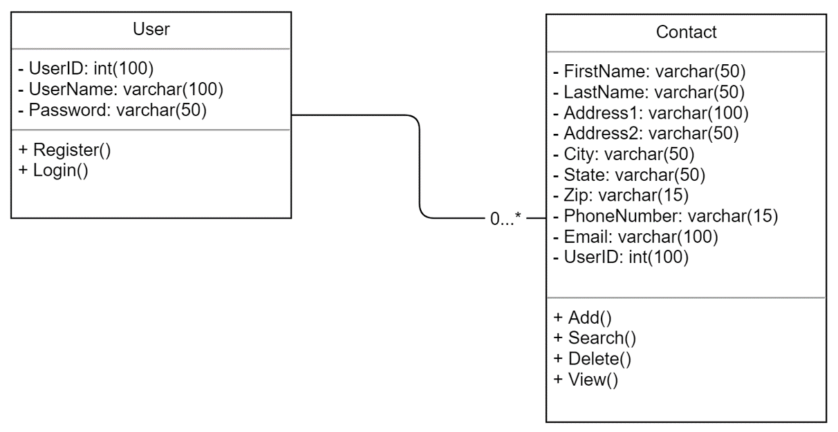
Class Diagram
Displays user and contact objects in our project

Slide 6
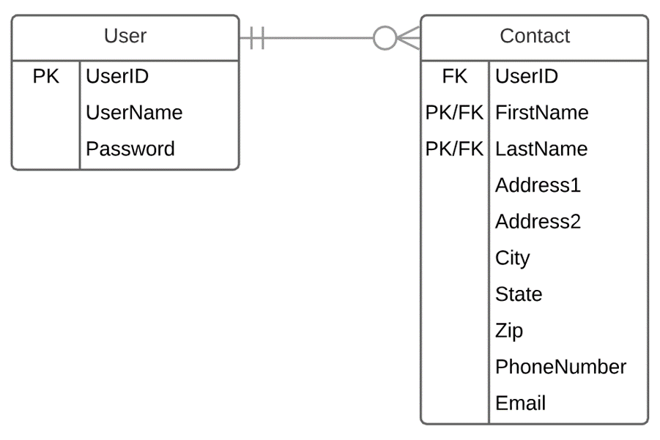
Entity Relationship Diagram
Displays exact data from each of our objects in the class diagram.
Used to communicate between tables in a database

Slide 7
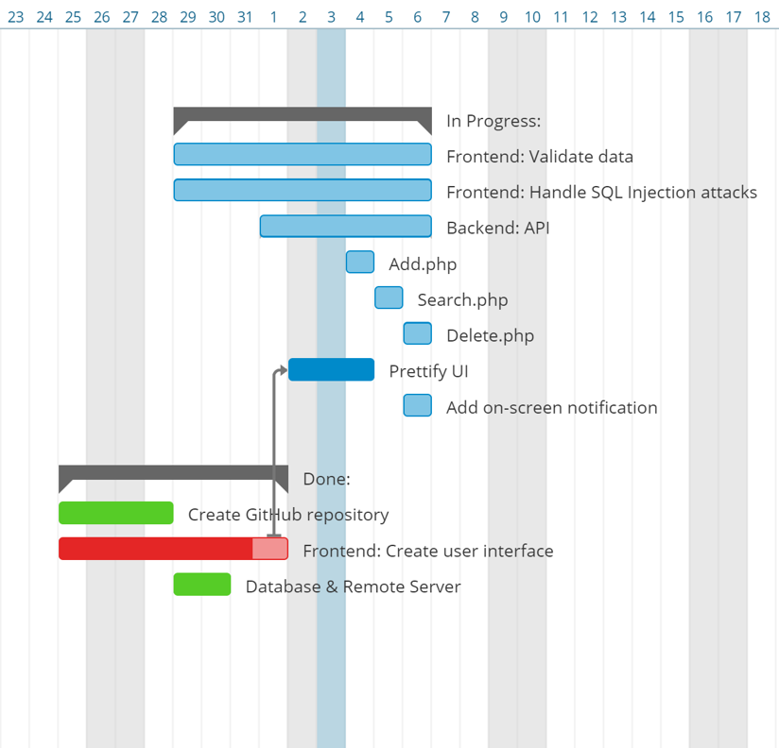
Gantt Chart
Useful for project progression
Used Asana as a base application to track tasks for each team member.

Slide 8
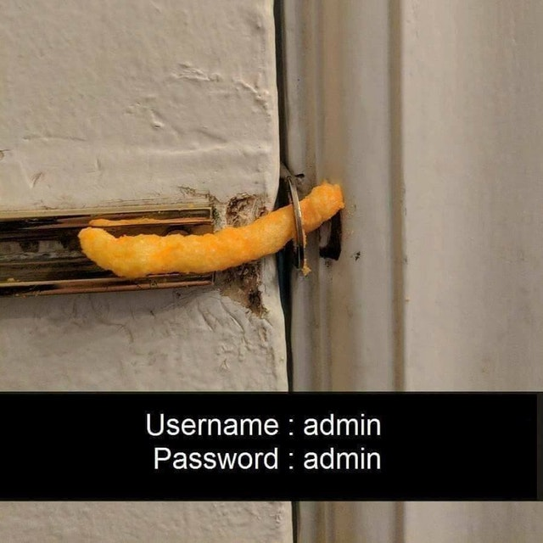
Difficulties Encountered
Frontend | API | Database
 | Understanding what an API is Learning PHP and HTML | Learning curve on running a website from a remote database Cheap web hosting service. Outdated software tools were used.

Slide 9
Successes
Frontend | API | Database
Making the webpage interactive with the javascript | Connecting to the database suing mysqli() and interacting with the website Learned about databases and how to use json conversion to communication with the frontend and backend | Designed and implemented a simplistic user database to assist in communication with the API team Knowledge of how the backend is ran on websites

Slide 10
LIVE DEMO

Slide 11
Questions?
Website
http://m4rks.site/
Github Repository
https://github.com/SudoKudo/P.O.O.P-Small-Project

